Slide 1
Sales Performance Analysis
Tableau 10 - Project
Student: Swati Nayak

Slide 2
INTRODUCTION
Industry: Ecommerce
Project Background : A head of Product Management of a retail products company, is responsible for determining which products his company should continue to offer for sale and which products should be discontinued from the company’s product catalog.
Objective : To build a dashboard that will present monthly sales performance by product segment and product category to help client identifying the segments and categories that have met or exceeded their sales targets, as well as those that have not met their sales targets.
Business Solution: To build a dashboard to show sales performance.

Slide 3
Data sets to be used :
Sample Superstore
Sales Target
Analysis Tasks :
Use the Saved Sample – Superstore dataset.
Create a bullet chart with Category and Segment dimensions and Sales measures.
Blend the data with the Saved Sample - Sales Target data set to bring in the Sales Target measure.
Color code the chart to identify Categories and Segments that are above or below target.
Add the year of sales to the view to identify trends and outliers.
Add a filter so that the user can select one, more than one, or all years.
Create a dashboard with this view.

Slide 4
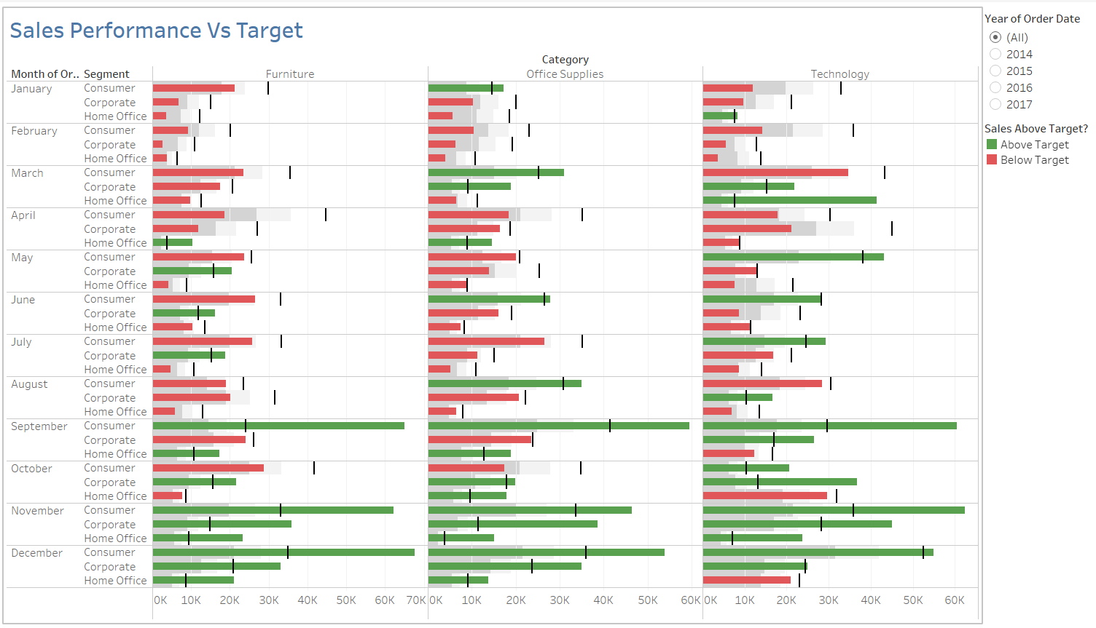
Screen Shot of Dashboard of Tableau Result

Slide 5
Result :
By creating the graphs and seeing the data visualization in Tableau, It is clearly evident that the sales of products above the target sales are shown in green color legend and sales of products below the target sales are shown in red color legend. Therefore, The company should continue to offer for sale for green marked products and discontinue the sale of red marked products from company’s product catalog.
Link of the Tableau File:
https://public.tableau.com/views/Swati_Final_Project/Swati_Final_Project?:embed=y&:display_count=yes&:origin=viz_share_link

Slide 6
Thank You

